Slide 1
Comprehensive Data Analysis Using Azure Services
DataCo Supply Chain

Slide 2
Project Overview
This project builds an end-to-end data engineering pipeline
Focus on data ingestion, transformation, storage, and visualization
Uses modern cloud tools in Azure ecosystem
Goal: Generate business insights from supply chain data

Slide 3
Objectives
Extract data
Store raw data in NoSQL landing zone
Transform data using PySpark in Databricks
Derive Insightful analysis
Load data to Azure SQL Database

Slide 4
Tools & Technologies
Azure Data Factory (ADF)
Azure Cosmos DB (NoSQL)
Azure Databricks (PySpark)
Azure SQL Database

Slide 5
Architecture Diagram
Data Source
Azure Data Factory
Cosmos DB
Databricks
SQL DB

Slide 6
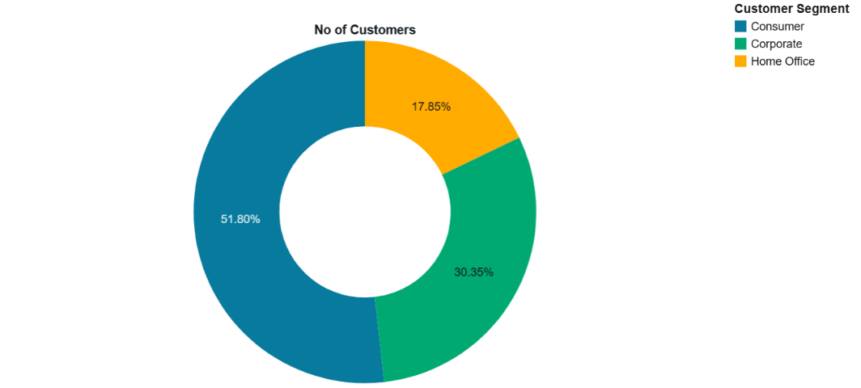
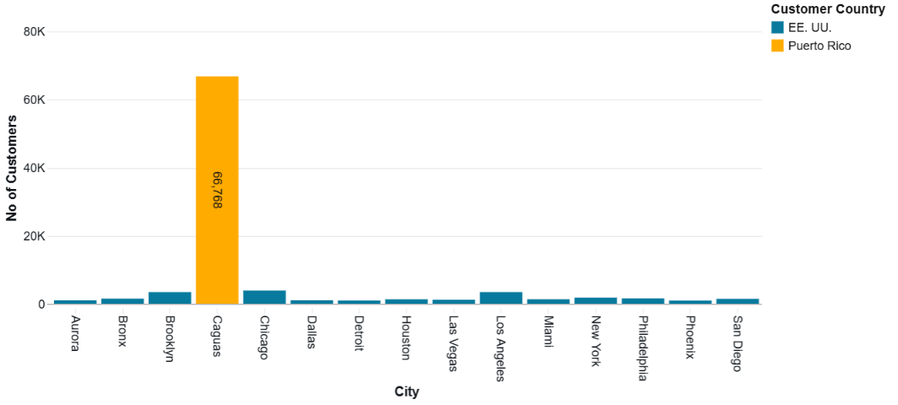
Customer Insights
Customers in different segment.
The number of customers across different cities.

Slide 7
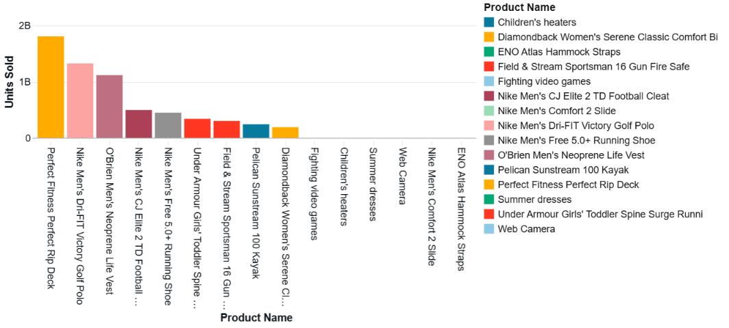
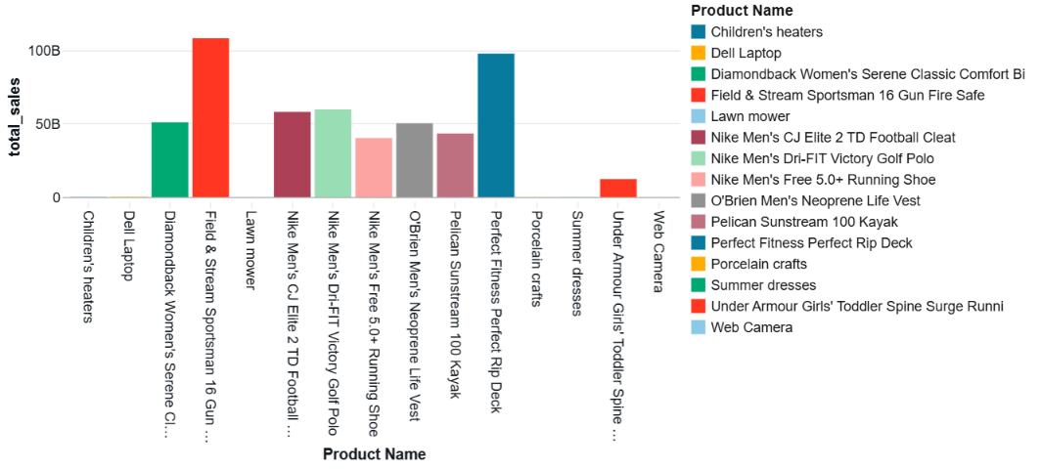
Product Insights
Units sold by each product
Total sales by each product.

Slide 8
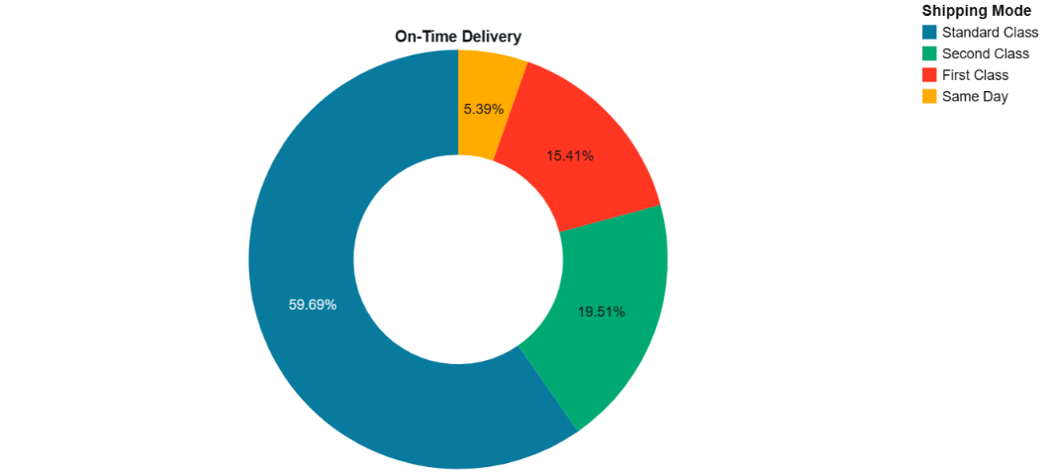
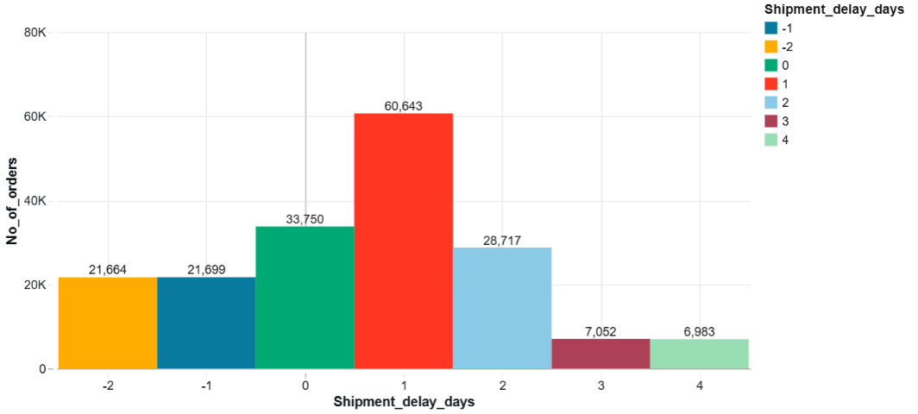
Order Insights
On-Time Delivery by Shipping Mode.
Shipment Delay Days vs Orders.

Slide 9
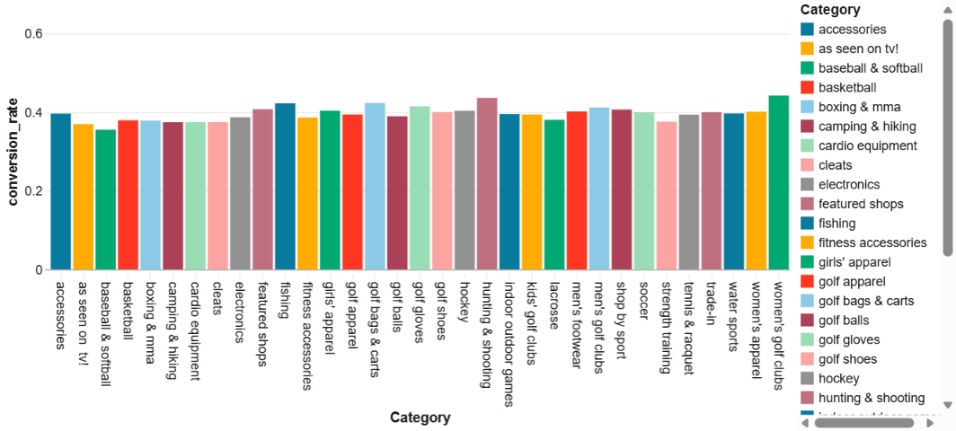
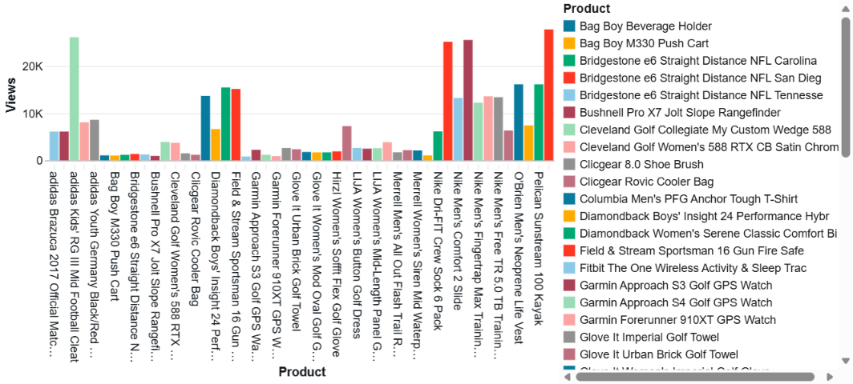
Logs Insights
Conversion Rate of Product Categories
Top Viewed Products.

Slide 10
Conclusion
Data was successfully ingested from Azure Cosmos DB, processed and transformed using PySpark, and then stored in Azure SQL Database.
The analysis covered multiple dimensions including customer segmentation, geographical distribution, product performance, delivery efficiency, and user behavior from logs.

